Slide 1
Web Application Development II
Week 10: Testing
10c: End-to-End Testing using Playwright

Slide 2
Agenda
Learning Outcomes
By the end of this lesson, you will learn that:
E2E testing verifies that an entire application works correctly from the user's perspective by testing complete workflows across all integrated components
Commonly-used modern E2E testing tools include PlayWright, Cypress, Selenium & Puppeteer
You can write & run an E2E test using Playwright
Definitions and Concepts
Unit Testing: Functions
Component & Integration Testing
E2E Testing

Slide 3
Different Types of Tests
End-to-end (E2E) testing verifies that an entire application works correctly from the user's perspective by testing complete workflows across all integrated components, services, & systems in a production-like environment.
Test Type | What is Tested? | Components Involved | Goal
Unit Test | A single unit (e.g., a function, method, or class) | One component in isolation | Verify that an individual unit works correctly.
Integration Test | The interaction between multiple units or modules | Two or more integrated components | Verify that the components work correctly together.
End-to-End (E2E) Test | The complete system from the user's perspective | Entire application, including databases, APIs, and UI | Verify that complete user workflows function correctly.
E2E testing verifies that an entire app works correctly from the user's perspective, ensuring that all components (frontend, backend, database, APIs, etc.) work together as expected:
Tests complete user workflows
Simulates real user interactions
Runs against the app as a whole

Slide 4


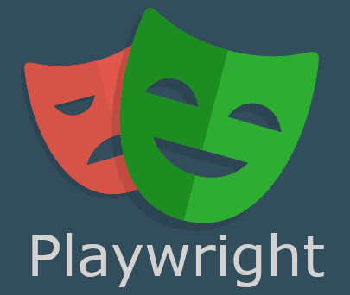

Tools
Comparison of modern E2E testing tools used in the industry:
.
 | Primary Use | Browser Support | Automatic Waiting | Programming Languages | Best For
Playwright | E2E testing | Chrome, Edge, Firefox, Safari | Yes | JS, TypeScript, Python, Java, .NET | Modern web applications
Puppeteer | Browser automation | Chrome/Edge/Firefox | No | JS, TypeScript | Web scraping, automation, PDFs, screenshots
Cypress | E2E testing | Chrome, Edge, Firefox | Yes | JS, TypeScript | Frontend E2E testing and beginners
Selenium | E2E testing | Almost all browsers | No | Java, Python, C#, JS & more | Enterprise, legacy, & modern applications
Automatic waiting is a feature of Playwright & Cypress that automatically waits for elements or page updates to be ready before performing an action or checking an assertion. This makes tests more reliable and eliminates the need for arbitrary delays. If a test tries to interact with an element before it is ready, the test may fail even though the application is working correctly.
Notes:
Students interested in Selenium can take a look at http://smu.sg/selenium (23 min)
Only Playwright will be covered in this course

Slide 5
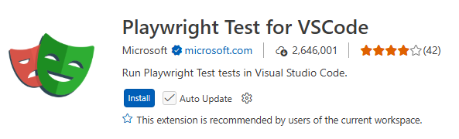
Playwright
Playwright is an open-source E2E testing framework developed by Microsoft for automating web browsers. It allows you to simulate real user interactions (e.g. clicking buttons, typing into forms, navigating pages, and verifying content) to ensure that an application works correctly from the user's perspective.
Playwright can automate user interactions in Chromium (Edge, Chrome), Firefox & WebKit (Safari) browsers
We will only cover PlayWright in this course
A Playwright test usually follows these steps:
Launch a browser.
Navigate to the application.
Interact with the page.
Verify the results.
Close the browser.
Vitest asks: "Does this piece of code work correctly?"
Playwright asks: "Can the user successfully complete a task?"

Slide 6
(Demo) Ex 3: E2E Testing on a Simple Web App
In this exercise, we will:
Install Playwright & the VSCode extension for Playwright
Host a very simple web app for testing
Record user actions on the web app using VSCode
Run the test and read the test results

Slide 7
Setting Up for Ex 3 (1)
Install Playwright: In a terminal window, type:
pnpm create playwright
Installation options: JavaScript
where to put e2e tests: tests
add a GitHub Actions workflow: false
install Playwright browsers: true
After successful installation, you will see tests/example.spec.js (default test file)
Verify that Playwright works: In the terminal window:
pnpm playwright test
You should see 6 tests (in example.spec.js) passing. Generate the test report:
pnpm exec playwright show-report
Then visit http://localhost:9323 (as prompted) to see the report
Notes:
If the test case fail, most likely due to browser version mismatched – the one supported by playwright and the one downloaded
pnpm exec playwright install webkit --force

Slide 8
Setting Up for Ex 3 (2)
(3) Examine tests/example.spec.js & understand the tests.
Basically the test visits https://playwright.dev and checks if the page's title has the string "Playwright". When the "Get Started" button gets clicked, the user will be directed to a page that has the string "Installation" in the title.
There are only 2 tests: "has title" and "get started link". These tests were done on 3 different browsers (chromium, firefox and webkit), making 6 tests in total.
If https://playwright.dev is up, you should see all 6 tests passing. You can disconnect from the Internet (or edit the URL in the test script), and run the test again to see them fail.

Slide 9
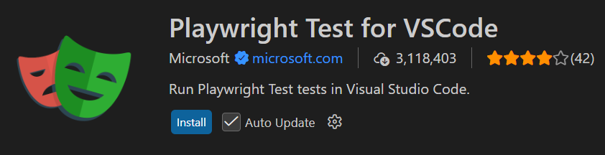
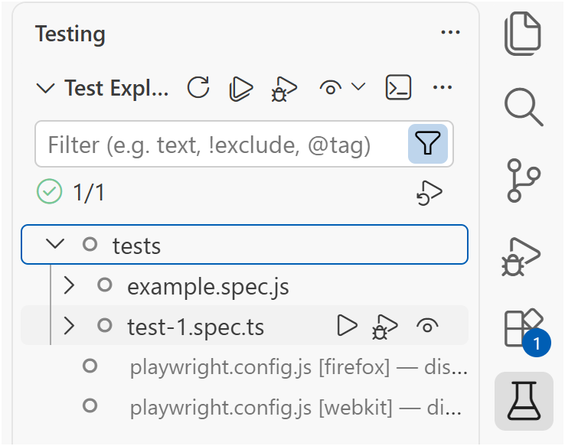
Setting Up for Ex 3 (3)
(4) Install Playwright extension for VS code
In VS Code, open Extensions (Ctrl+Shift+X). Search for "Playwright Test for VS Code" published by Microsoft and install it. Restart VS Code if necessary.
On the Activity Bar of VS code, you'll now see a Testing icon (looks like a laboratory flask). Click on it to open Test Explorer. You may see an error message "No tests have been found in this workspace yet".
In VS Code, open the folder where you installed Playwright, and you should see your default disabled tests in the Test Explorer.
  If you don’t see it, expand “Playwright”. Under “Configs”, select ”playwright.config.js” file that was created when you run pnpm create playwright (slide 7)
Expand "tests" to see example.spec.js. Right-click on example.spec.js and select "Go To Test" to see the source file (you used this same test in the previous step)
Click on the "play" icon just beside example.spec.js to run the test.
You can see the test results in the "Test Results" tab of the VS Code "Panel". (If you don't see the "Panel", from the VS Code menu bar, click View->Appearance->Panel to open it)
"Lab Flask" icon on VS Code's Activity Bar

Slide 10
Setting Up for Ex 3 (4)
(5) Host a simple Web App for testing
Copy index.html to the folder where you will host it on your laptop.
Start a local web server. You can host index.html on Node (or any other local web server).
Alternatively if you don't have a web server running, open terminal, cd to the folder containing index.html, and type:
pnpm dlx http-server
This downloads and runs a simple http server on your laptop. ("dlx" is pnpm's command for temporarily downloading and running a package without installing it permanently in your project)
View the hosted index.html in a browser to ensure that it's running: http://127.0.0.1:8080 (or whichever port mentioned in the prompt). Try entering "admin" and "1234" for a successful login; also observe the error message when login fails.
Notes:
<!-- index.html -->
<!DOCTYPE html>
<html>
<body>
<h1>Login</h1>
<input id="username" placeholder="Username">
<input id="password" type="password">
<button id="login">Login</button>
<p id="message"></p>
<script>
document.getElementById("login").onclick = () => {
const user = document.getElementById("username").value;
const pass = document.getElementById("password").value;
if (user === "admin" && pass === "1234")
document.getElementById("message").innerText = "Welcome Admin!";
else
document.getElementById("message").innerText = "Login Failed";
};
</script>
</body>
</html>

Slide 11
(Demo) Ex3: E2E Testing On a Simple Web App
Record user actions and automatically generate Playwright code
In the Playwright panel (usually under Test Explorer), click "Record new". A browser opens with a pink page background. In VS Code, you can see a new default test file (test-1.spec.ts) file being generated.
In the browser that opened, type in the URL: http://127.0.0.1:8080 and hit ENTER. In the VS Code window, notice that statements are automatically inserted into a default test file as your actions are "recorded".
Type in "admin" and "1234" for the username and password fields and click on Login for a successful login. The "Welcome Admin!" text should appear. Click on "Welcome Admin!".
Close the browser to stop recording, & observe the test file that has been generated (see next slide). Remove unnecessary statements that were recorded.
The last statement simulates a mouse click on the "Welcome Admin!" text. Change that to an assertion instead:
await expect(page.getByText('Welcome Admin!')).toBeVisible();
Notes:
// 1st test for successful login
import { test, expect } from '@playwright/test';
test('test', async ({ page }) => {
await page.goto('http://127.0.0.1:8080/');
await page.getByRole('textbox', { name: 'Username' }).click();
await page.getByRole('textbox', { name: 'Username' }).fill('admin'); // correct user ID
await page.getByRole('textbox', { name: 'Username' }).press('Tab');
await page.locator('#password').fill('1234'); // correct password
await page.getByRole('button', { name: 'Login' }).click();
// await page.getByText('Welcome Admin!').click(); // to be removed manually
await expect(page.getByText('Welcome Admin!')).toBeVisible(); // manually inserted
});

Slide 12
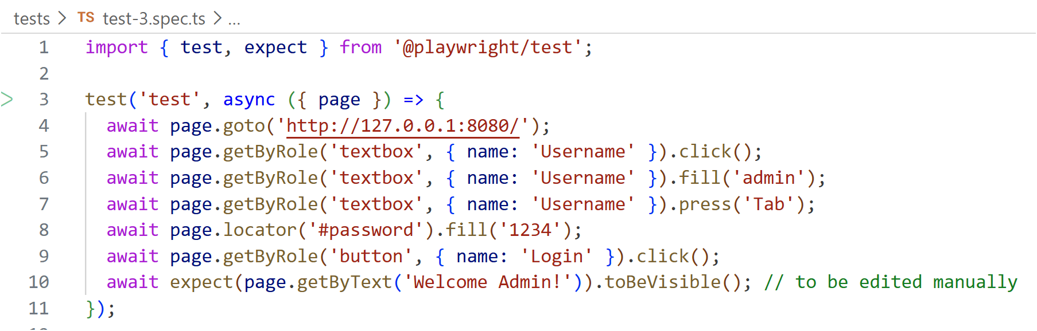
Ex3 (2)
Test generated automatically by recording:
Edit the last statement manually to an assertion.
Notes:
// 1st test for successful login
import { test, expect } from '@playwright/test';
test('test', async ({ page }) => {
await page.goto('http://127.0.0.1:8080/');
await page.getByRole('textbox', { name: 'Username' }).click();
await page.getByRole('textbox', { name: 'Username' }).fill('admin'); // correct user ID
await page.getByRole('textbox', { name: 'Username' }).press('Tab');
await page.locator('#password').fill('1234'); // correct password
await page.getByRole('button', { name: 'Login' }).click();
// await page.getByText('Welcome Admin!').click(); // to be removed manually
await expect(page.getByText('Welcome Admin!')).toBeVisible(); // manually inserted
});

Slide 13
Ex3 (3)
'test' is the default name of this test case. You should change this to something more descriptive such as "should successfully log in with valid credentials"
async means the function contains asynchronous operations. Because await is used, the surrounding function must be declared with async.
page represents a browser page controlled by Playwright.
test() is used to define a test case.
Recall that test() is the same as it().
page.getByRole('button',….).click() locates a button with role (of button) and accessible name (Login). Then simulate a user click.
await pauses execution at that point until the async operation is complete. So here, the await keyword waits for Playwright to complete going to the URL before continuing to the next line. Without await, the program could start tryhing to find the Username textbox before the page has finished loading!
Assertion in the test.
page.getByText('Welcome Admin!') locates an element containing the text 'Welcome Admin!'.
.toBeVisible() is the matcher
In plain English:
I expect the text "Welcome Admin!" to be visible on the page.
There are 3 stages in most tests:
(1) setup: go to a particular page (line 4)
(2) actions: enter credentials & log in (lines 5-9)
(3) assert: verify that login was successful (line 10)

Slide 14
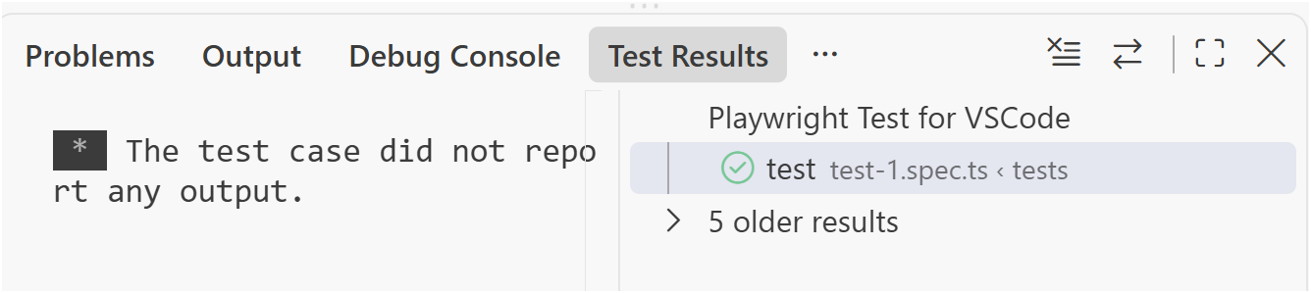
Ex3 (4)
(2) Run the recorded test
Select the test.spec.ts file you have just generated in Text Explorer. Click on the "play" icon at the right of the file name to run the test.
The test should pass at this point (unless your web server is down). You can see the test results in the "Test Results" tab.
Run the test
Test that was recorded using plugin
Test results

Slide 15
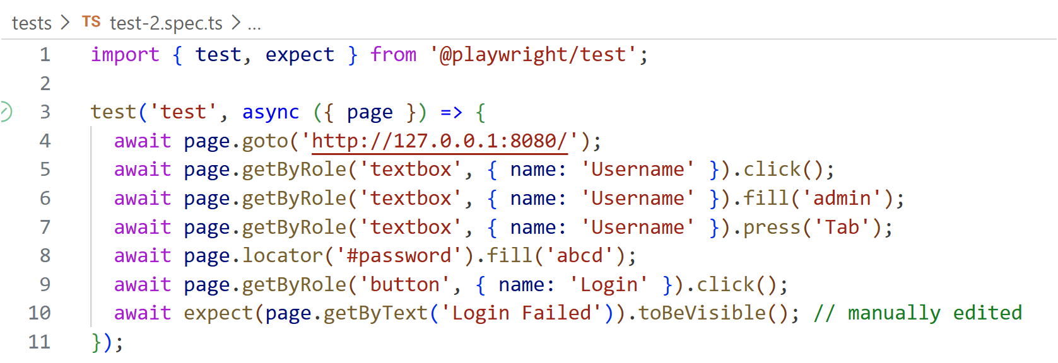
Ex3 (5)
(3) Record a 2nd test (for Failed Login)
Click "Record new" again and record the actions to attempt to log in using an invalid user account (e.g. Admin/abcd).
When you click on the Login button, the text "Login Failed" appears instead of "Welcome Admin!".
Edit the last statement to assert that the text which appears is "Login Failed"
Run this 2nd test to ensure it passes.
You can run all the tests cases in your test suite by clicking on the "play" icon for the "tests" folder in Test Explorer instead of an individual test case
Edit the last statement manually to an assertion.
Notes:
// 2nd test for failed login
import { test, expect } from '@playwright/test';
test('test', async ({ page }) => {
await page.goto('http://localhost:8080/');
await page.getByRole('textbox', { name: 'Username' }).click();
await page.getByRole('textbox', { name: 'Username' }).fill('admin'); // correct user ID
await page.getByRole('textbox', { name: 'Username' }).press('Tab');
await page.locator('#password').fill('abcd'); // wrong password
await page.getByRole('button', { name: 'Login' }).click();
// await page.getByText('Login Failed').click(); // to be removed manually
await expect(page.getByText('Login Failed')).toBeVisible(); // manually inserted
});

Slide 16
Ex3 (6)
(4) Deliberately break a test
We want to observe what happens when a test fails.
Choose one of the 2 tests you have recorded and edit the assertion statement so that the test fails. e.g. we can edit the 1st test so that it fails.
Run the test and see the failed test and the error message.
(Instead of clicking on the "play" icon, you can click on the "Debug" icon. In debug mode, you can set breakpoints in the test code, "step over" an error when a failure occurs and inspect variables.)
The objective of this exercise is to see what happens when a test fails. You should not be deliberately writing tests that fail.
Notes:
// 3rd test that should fail. Wrong login, but showing "Welcome Admin"
import { test, expect } from '@playwright/test';
test('test', async ({ page }) => {
await page.goto('http://127.0.0.1:8080/');
await page.getByRole('textbox', { name: 'Username' }).click();
await page.getByRole('textbox', { name: 'Username' }).fill('peter'); // wrong user ID
await page.getByRole('textbox', { name: 'Username' }).press('Tab');
await page.locator('#password').fill('1234'); // correct password
await page.getByRole('button', { name: 'Login' }).click();
await expect(page.getByText('Welcome Admin!')).toBeVisible(); // this should fail
});

Slide 17
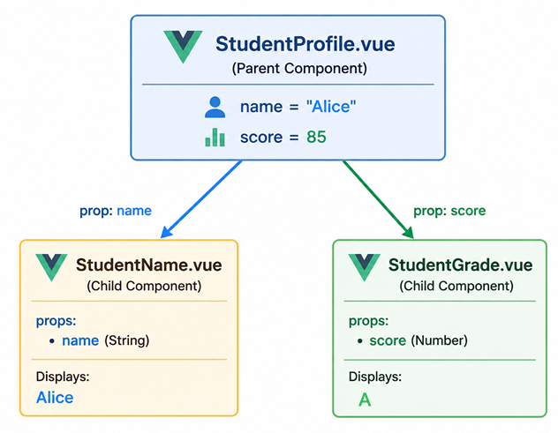
Ex3a: E2E Testing for a Vue App
Now that you are familiar with using PlayWright for E2E testing, host the Vue app we used for exploring component/integration testing.
Replace Ex2.vue with the new version of Ex2.vue. The new version presents a form to the user for him to key in the name and score.
A workflow that can be tested will be:
Enter a student's name and score. Click Submit.
The student's name and the correct letter grade is displayed.
Create an E2E test that checks this workflow using what you have learnt.

Slide 18
TakeAways
E2E testing verifies that an entire application works correctly from the user's perspective by testing complete workflows across all integrated components
The commonly-used modern E2E testing tools include Playwright, Cypress, Selenium & Puppeteer
Practical testing skills:
Write & run an E2E test using Playwright for a web application using the Playwright VS Code plugin and manually editing relevant statements in the recorded test code.

